Slide 1
Web Services
Michael Smith
Alex Feldman

Slide 2
What is a Web Service?
A Web service is a message-oriented software system designed to support inter-operable machine-to-machine interaction over a network.
It has an interface described in a machine processable format (specifically WSDL).
Other systems interact with the Web service in a manner prescribed by its service description using SOAP messages, typically conveyed using HTTP with an XML serialization in conjunction with other Web-related standards. (W3C.ORG)

Slide 3
Why Web Services?
Middleware fragmentation
  Many systems do not inherently interoperate well
  Many implementations are in use
Web as an information distributor
  Ubiquity
  Simplicity of access
Act as a glue over existing middleware systems (another n-tier architecture layer)

Slide 4
Web Service Components
Service -
  An abstract resource.
  Set of functionality implemented by one or more Agents
Agent -
  Concrete computational resource (software or hardware).
  Agents send and receive Messages
Message
  Machine processable unit of data sent from one Agent to another
  Described by a service description language (e.g WSDL)
  Implemented in SOAP
Web Service Description (WSD) -
  A machine processable description of a service (in WSDL)
  Defines the message formats, data types, transport protocols and one or more network locations (URLs) where the service can be reached.

Slide 5
Web Service Technologies
XML
  eXtensible Markup Language (SGML derivative)
  A standard, flexible and extensible data format
SOAP
  Simple Object Access Protocol
  Provides a standard, extensible, composable framework for packaging and exchanging XML-based messages
UDDI
  Universal Description, Discovery and Integration
  A SOA system of record (a discovery service)
WSDL
  Web Services Description Language
  Defines the messages that are exchanged between the requester and provider agents

Slide 6
Major Styles of Web Services
Representational State Transfer (REST)
  Purpose of the service is to manipulate XML representations of Web resources using a uniform set of "stateless" operations (similar to HTTP)
  uniform - Constrain the interface to a small standard set of well known operations (GET, PUT, DELETE, etc.)
  stateless - message does not depend on the state of the conversation.
Service Oriented Architecture (SOA)
  Message Oriented service model
  Can be very complex
Remote Procedure Call (RPC)
  Arbitrary Web services, in which the service may expose an arbitrary set of operations (methods, functions).
  Generally the simplest implementation

Slide 7
Web Service vs Traditional RPC
Web Service
Uses HTTP protocol, which is relatively slow
Platform Independant
Works for machines behind NATed firewalls
Standardized for the world community
Loosely coupled
RPC
Uses a binary protocol which is very fast
Native to certain programming environments
Tightly coupled

Slide 8
Useful for Applications
That must operate over the Internet where reliability and speed cannot be guaranteed.
Where there is no ability to manage deployment so that all requesters and providers are upgraded at once.
Where components of the distributed system run on different platforms and vendor products.
Where an existing application needs to be exposed for use over a network, and can be wrapped as a Web service.

Slide 9
Service Semantics
Semantics for a desired interaction must be defined in order to create services. Primary methods:
Specified by a Standards Body
Provider mandated
Provider/Consumer agreement
Standards
Body
Semantics
Service
Consumer
Service
Provider

Slide 10
Discovery Services
Service Requester: Downloads WSD from the Discovery Service
Service Provider:
Publish WSD + FD
to Discovery Service
Discovery
Service
Service
Consumer
Service
Provider
WSD – Web Service Description | FD – Functional Description

Slide 11
Services In Action
Agent
Interaction
Agent
WSD + Semantics
WSD + Semantics
Service
Consumer
Service
Provider
Consumer’s Domain
Provider’s Domain

Slide 12
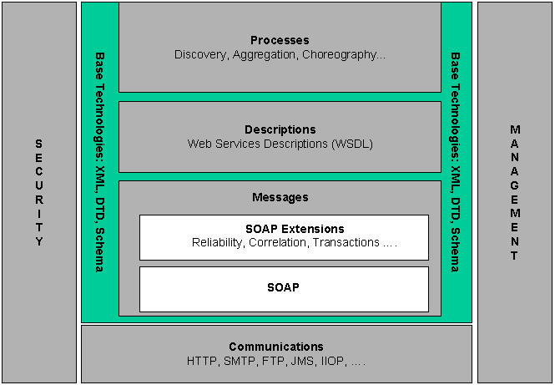
Architecture Stack
N-tier architecture
Crosscutting
Domains:
* Management
* Security & Policy

Slide 13
WSDL File – Service Defn.
<?xml version="1.0"?>
<!-- root element wsdl:definitions defines set of related services -->
<wsdl:definitions name="EndorsementSearch“ targetNamespace="http://namespaces.snowboard-info.com"
xmlns:es="http://www.snowboard-info.com/EndorsementSearch.wsdl"
xmlns:esxsd="http://schemas.snowboard-info.com/EndorsementSearch.xsd"
xmlns:soap="http://schemas.xmlsoap.org/wsdl/soap/"
xmlns:wsdl="http://schemas.xmlsoap.org/wsdl/">
<!-- wsdl:types encapsulates schema definitions of communication types;
here using xsd -->
<wsdl:types>
Service
Schema
WSDL
‘Home’
Service
Namespace
Service
Name

Slide 14
WSDL File – Data Types
<!-- xsd definition: GetEndorsingBoarder [manufacturer string, model string] -->
<xsd:element name="GetEndorsingBoarder">
<xsd:complexType>
<xsd:sequence>
<xsd:element name="manufacturer" type="string"/>
<xsd:element name="model" type="string"/>
</xsd:sequence>
</xsd:complexType>
</xsd:element>
Component Elements
Schema
Element

Slide 15
WSDL File - Messages
<!-- request GetEndorsingBoarderRequest is of type GetEndorsingBoarder -->
<wsdl:message name="GetEndorsingBoarderRequest">
<wsdl:part name="body" element="esxsd:GetEndorsingBoarder"/>
</wsdl:message>
<!-- response GetEndorsingBoarderResponse is of type
GetEndorsingBoarderResponse -->
<wsdl:message name="GetEndorsingBoarderResponse">
<wsdl:part name="body" element="esxsd:GetEndorsingBoarderResponse"/>
</wsdl:message>
Message
Content
Definition
Message
Name

Slide 16
WSDL File - Operations
<!-- the value of wsdl:operation eludes me -->
<wsdl:operation name="GetEndorsingBoarder">
<wsdl:input message="es:GetEndorsingBoarderRequest"/>
<wsdl:output message="es:GetEndorsingBoarderResponse"/>
<wsdl:fault message="es:GetEndorsingBoarderFault"/>
</wsdl:operation>
Action to take (message to generate)
Operation
Name

Slide 17
Example - SOAP Message
<SOAP-ENV:Envelope
xmlns:SOAP-ENV="http://schemas.xmlsoap.org/soap/envelope/"
SOAP-ENV:encodingStyle="http://schemas.xmlsoap.org/soap/encoding/">
<SOAP-ENV:Body>
<m:GetEndorsingBoarder xmlns:m="http://namespaces.snowboard-info.com">
<manufacturer>K2</manufacturer>
<model>Fatbob</model>
</m:GetEndorsingBoarder>
</SOAP-ENV:Body>
</SOAP-ENV:Envelope>
Namespace where message is defined
Message
Name
Message
Parameters

Slide 18
Resources
W3C.ORG (Feb 2004)
  Web Services Architecture
    http://www.w3.org/TR/ws-arch/
  Annotated WSDL Examples:
    http://www.w3.org/2001/03/14-annotated-WSDL-examples.html
Web Services Tutorial
  http://www.w3schools.com/webservices/default.asp
Web Services Primer
  http://webservices.xml.com/pub/a/ws/2001/04/04/webservices/index.html
IBM Tutorial
  http://www6.software.ibm.com/developerworks/education/wsbasics/wsbasics-ltr.pdf

